Slide 1
Writing Maintainable JavaScript
Paul Mendoza

Slide 2
What is maintainable code?
Self documenting
Consistent
Predictable
Easy to change

Slide 3
JavaScript Basics
Only FIVE primitive types in JavaScript
Number
String
Boolean
null
undefined
functions

Slide 4
JavaScript Basics
No classes
Inheritance through “prototype” property
There is always a host object.
In a web browser this is always called “window”

Slide 5
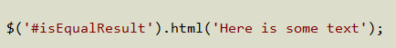
JavaScript Helper Libraries
jQuery, MooTools, dojo
Solves the browser consistency problems
Performance
Not all browsers support the same features
Use the $ sign to use.

Slide 6
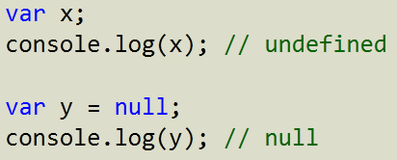
undefined vs null

Slide 7
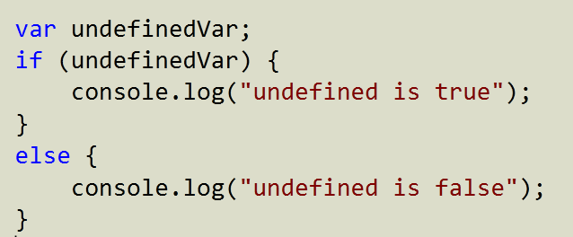
undefined and null as false

Slide 8
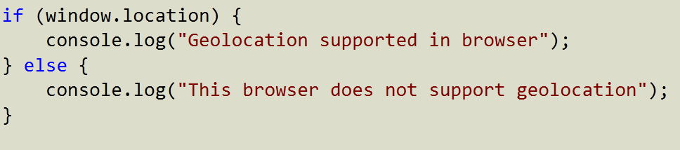
Feature Testing

Slide 9
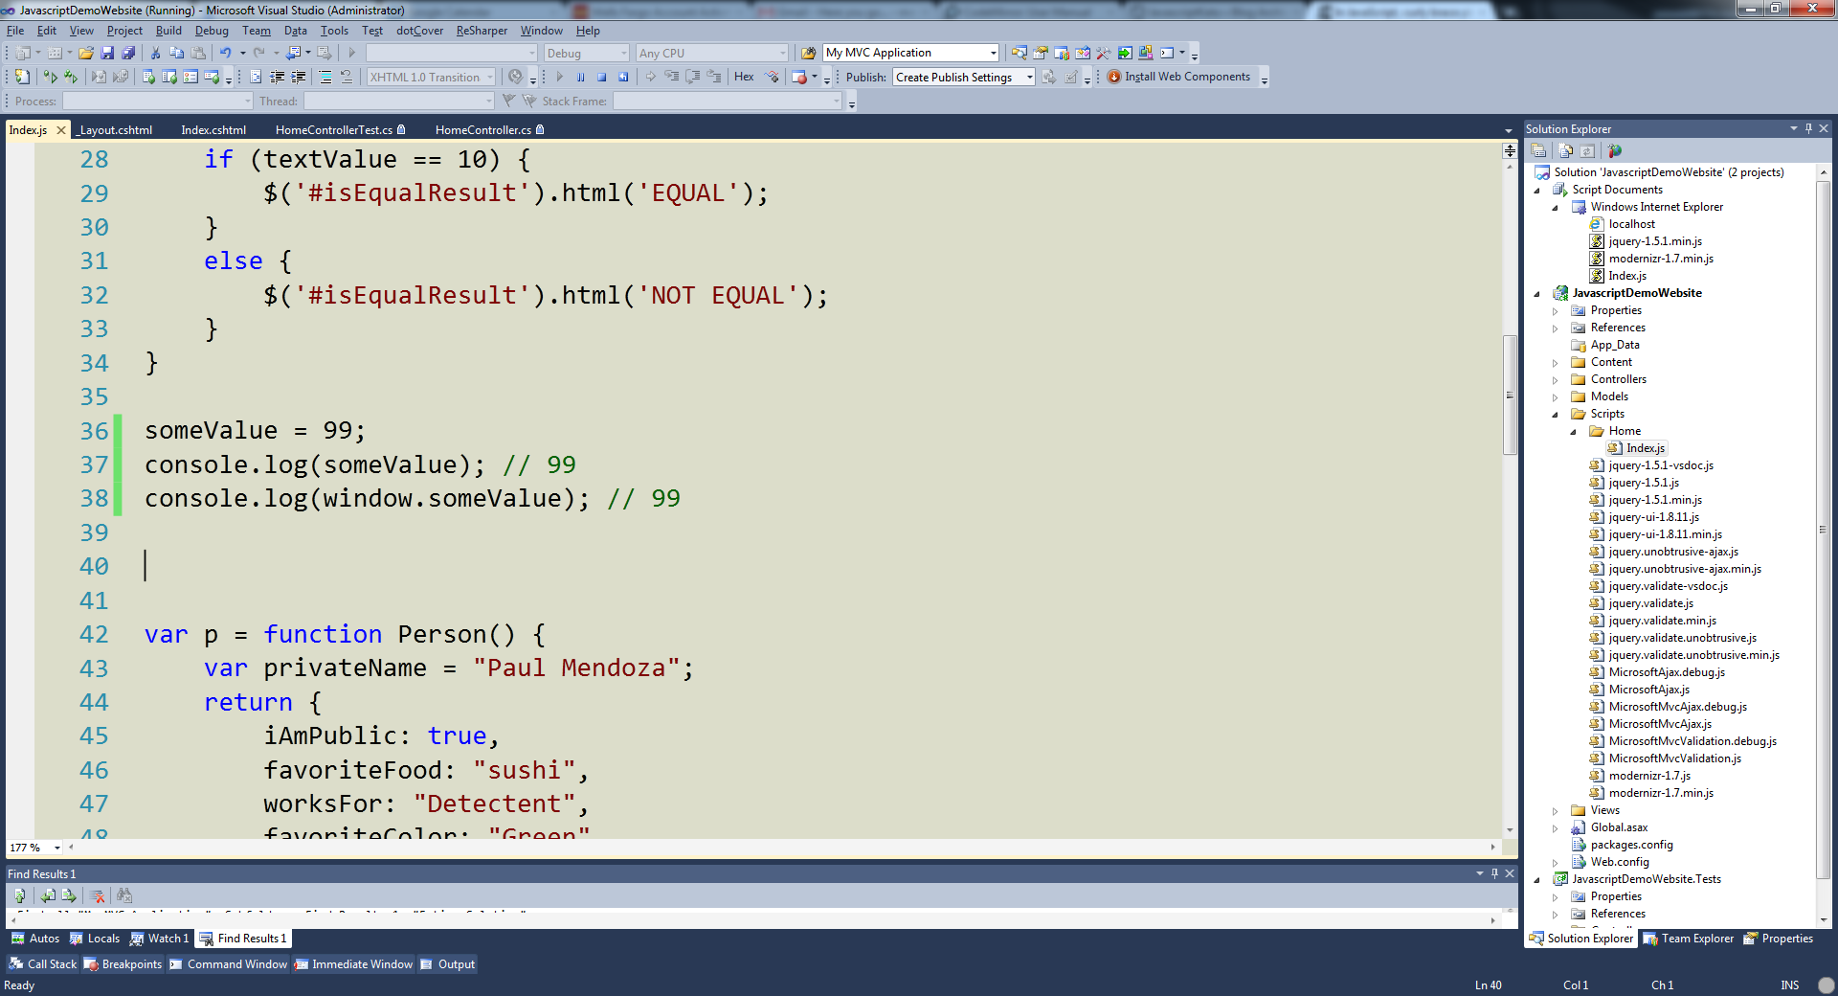
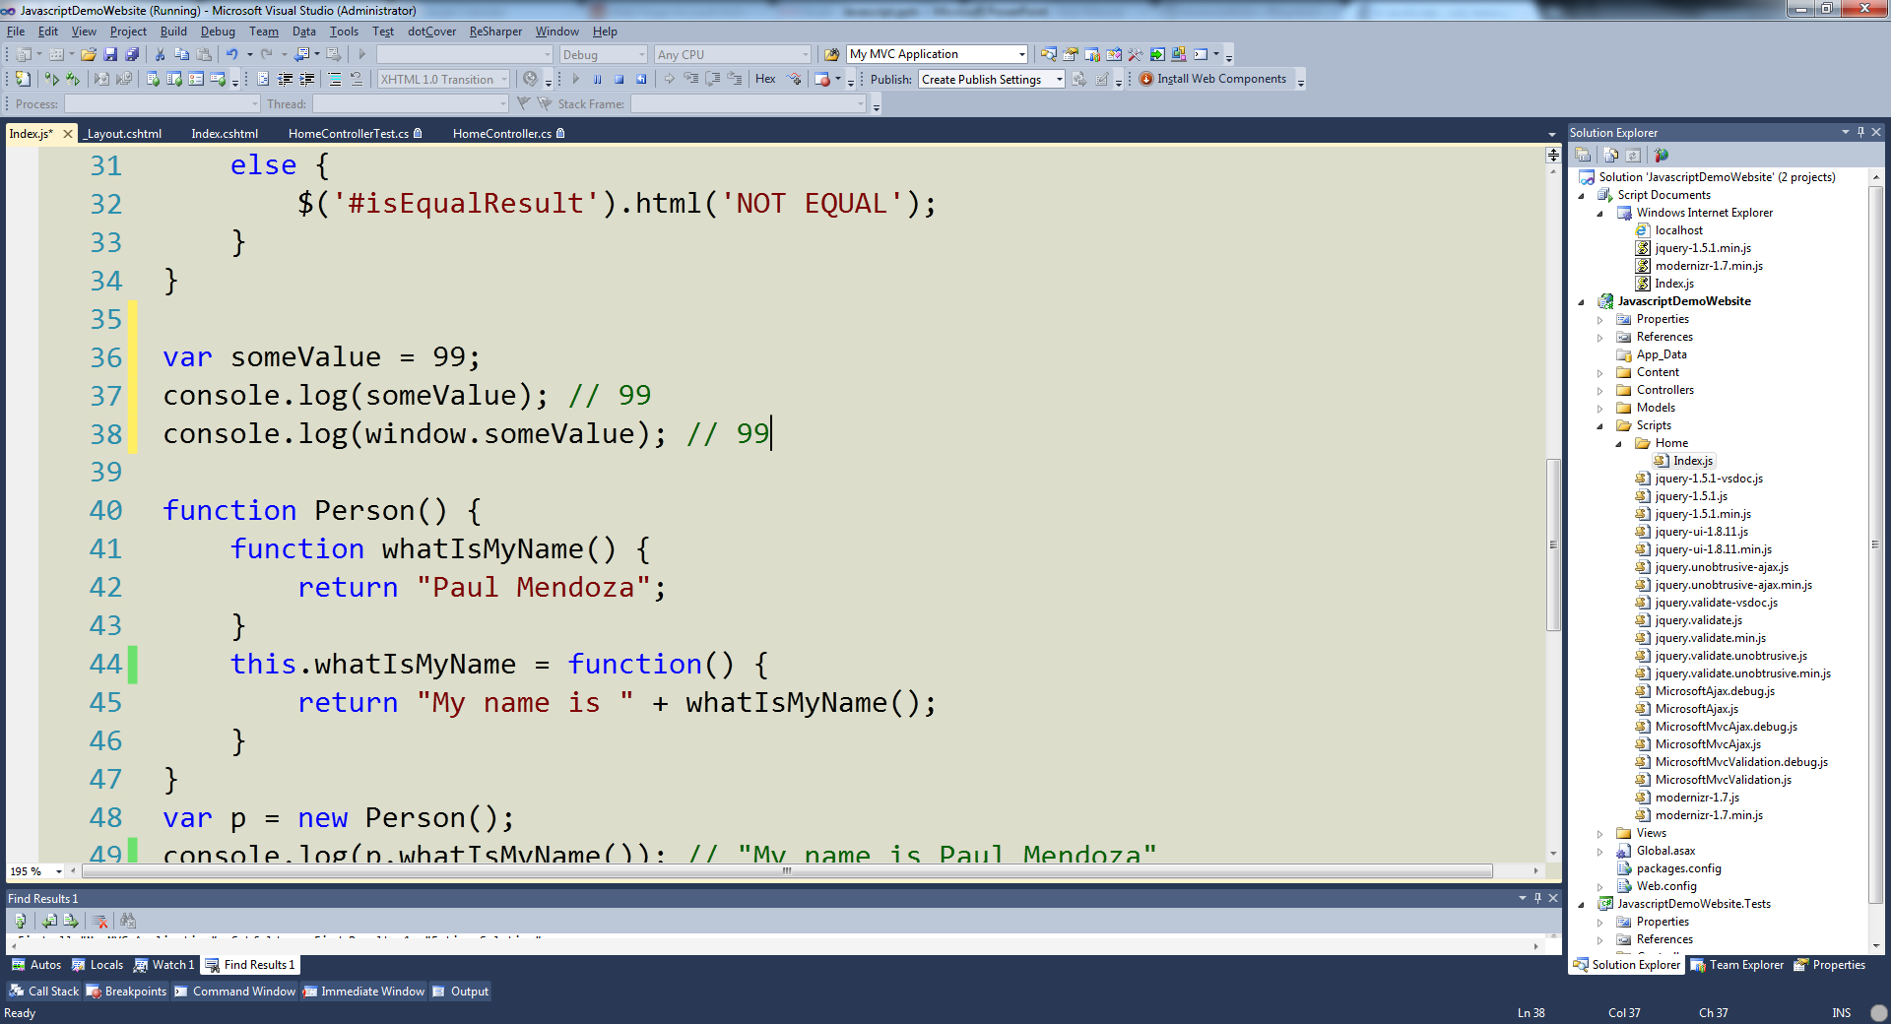
Global Variables
SAME AS

Slide 10
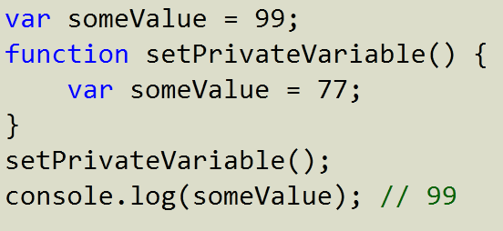
Function Scope

Slide 11
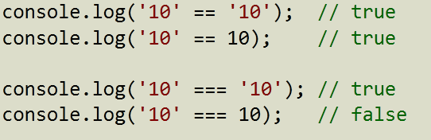
Double VS Triple Equality

Slide 12
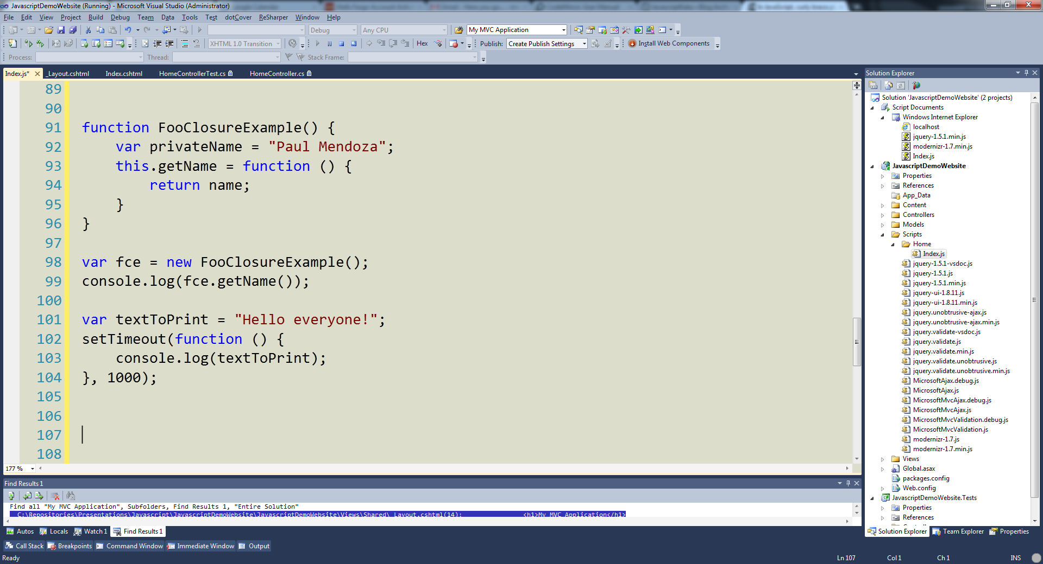
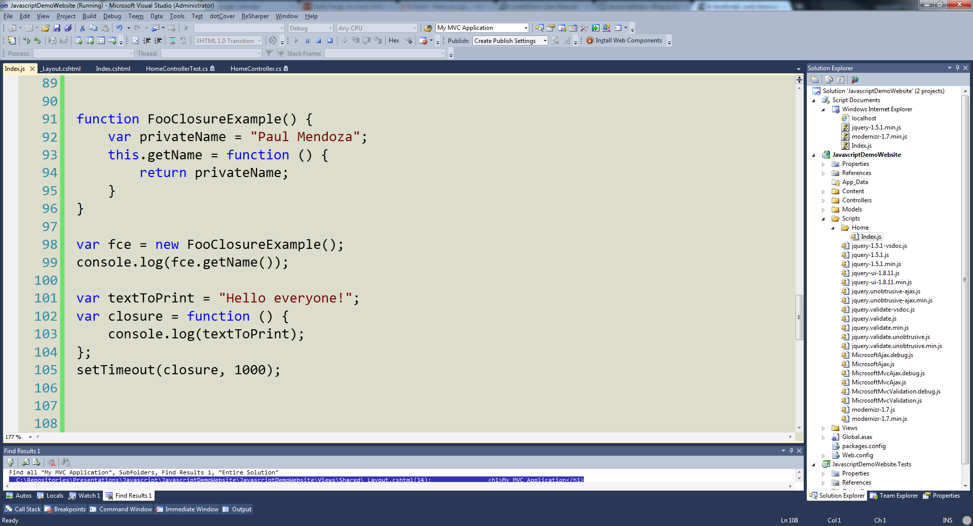
Closures
Same As

Slide 13
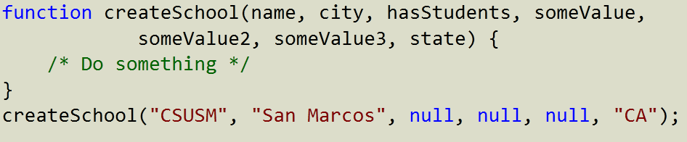
No Named Parameters
Notes:
Not clear to reader what null null null all are used for without looking at the function itself.
No named parameters in JavaScript

Slide 14
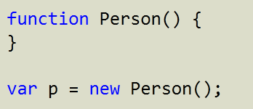
New Object Pattern

Slide 15
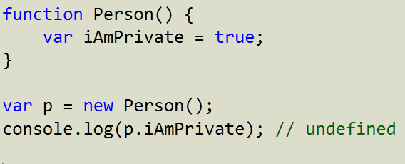
Private Variables

Slide 16
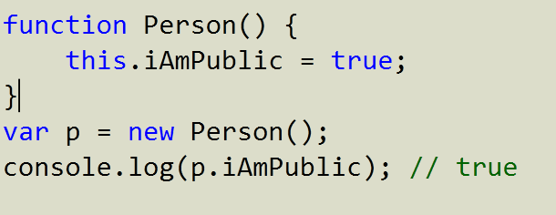
Public Variables
“this” keyword exposes variable to external callers

Slide 17
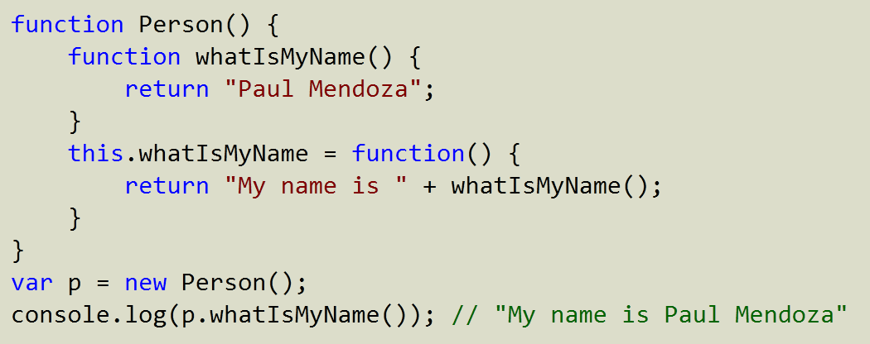
Public and Private Functions (Closures)

Slide 18
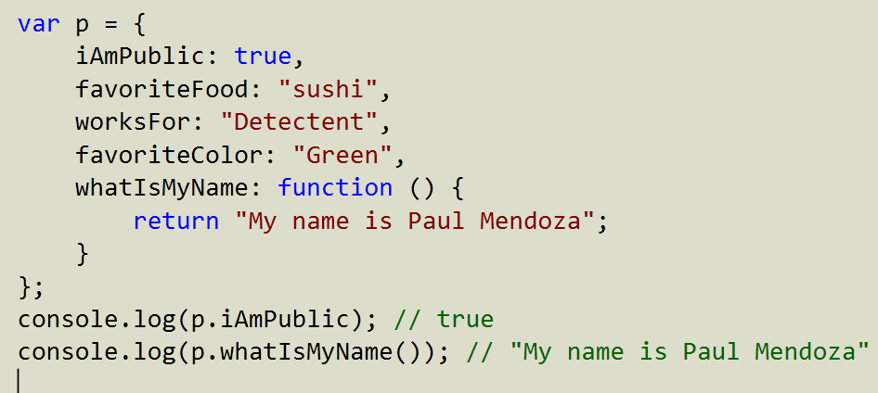
JavaScript Object Notation

Slide 19
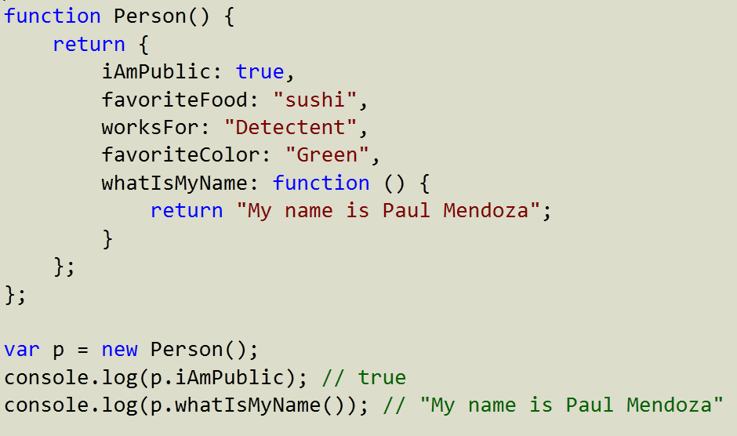
Constructor Return Statement

Slide 20
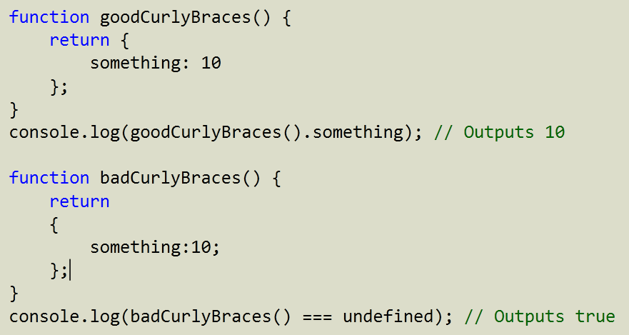
Curly Brace Placement Matters

Slide 21
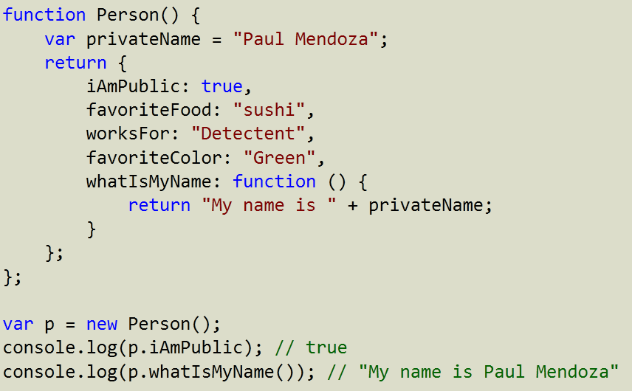
Private Variables With JSON Return
Notes:
privateName is a private variable.
Everything on the JSON object is public though.

Slide 22
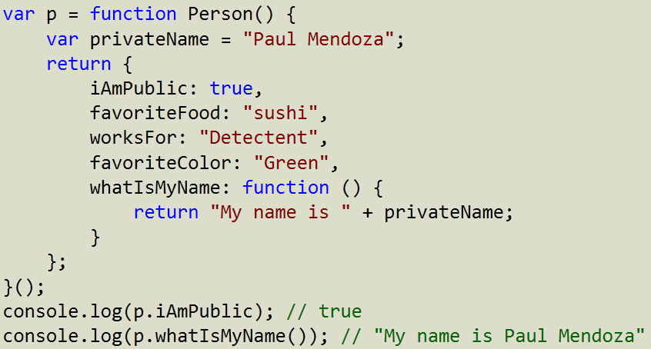
Self Invoking Functions

Slide 23
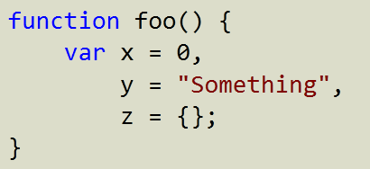
Single var Pattern
Declare all variables at the top to avoid undefined variables later in code.

Slide 24
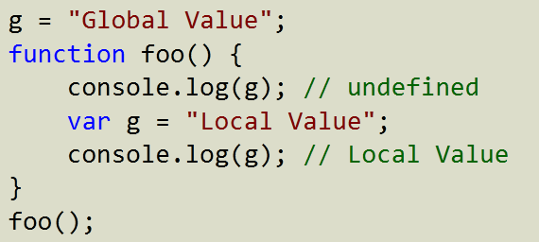
Hoisting
Declare all variables at the top of functions to avoid the hoisting problem below.

Slide 25
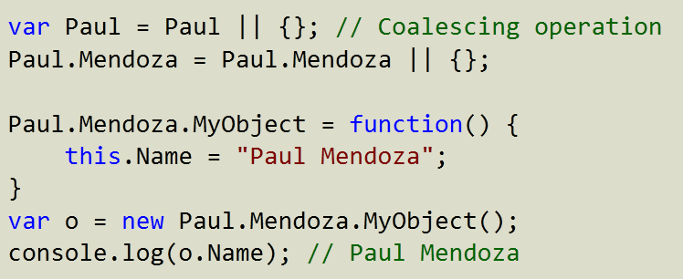
Namespaces

Slide 26
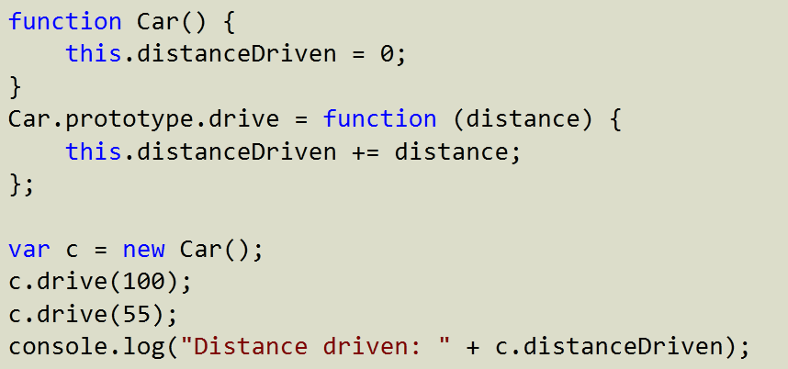
Prototype

Slide 27
Intellisense and Visual Studio 2010
DEMO TIME

